Slide 1
Machine Learning
Lecture 2: Review of Linear Algebra and Python Libraries

Slide 2
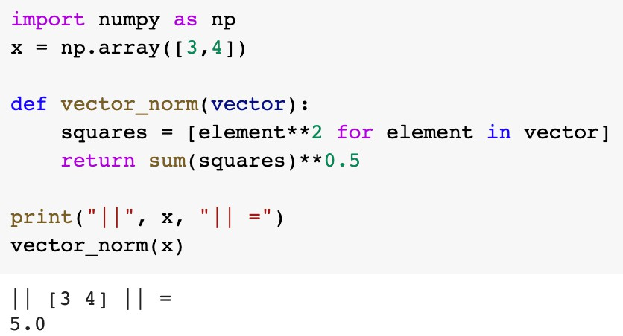
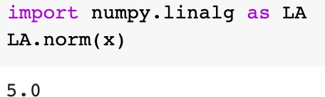
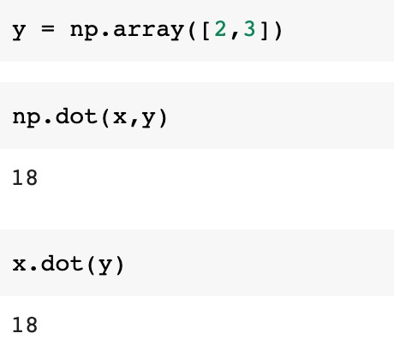
Norm and dot product for vectors
Norm
x₁ x₂
n
x =
2
, ∥x∥ = ∑ x_{i}
⋮
^{x}n
i=1
n
⟨x, y⟩ = ∑ x_{i}y_{i}
i=1
Dot product or inner product

Slide 3
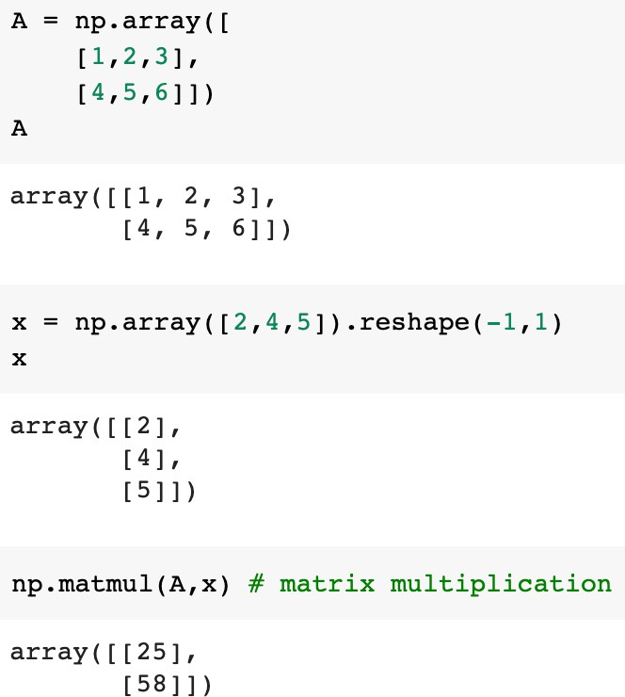
Matrix multiplication
Let us consider the following form
ª11 x₁ ⋮ + … + x_{n} ⋮ = ⋮
ªm1
…
x₁
ª11
ª1n
ª1n
⋮
⋮
ªm1
ªmn
…
ªmn ^{x}n

Slide 4
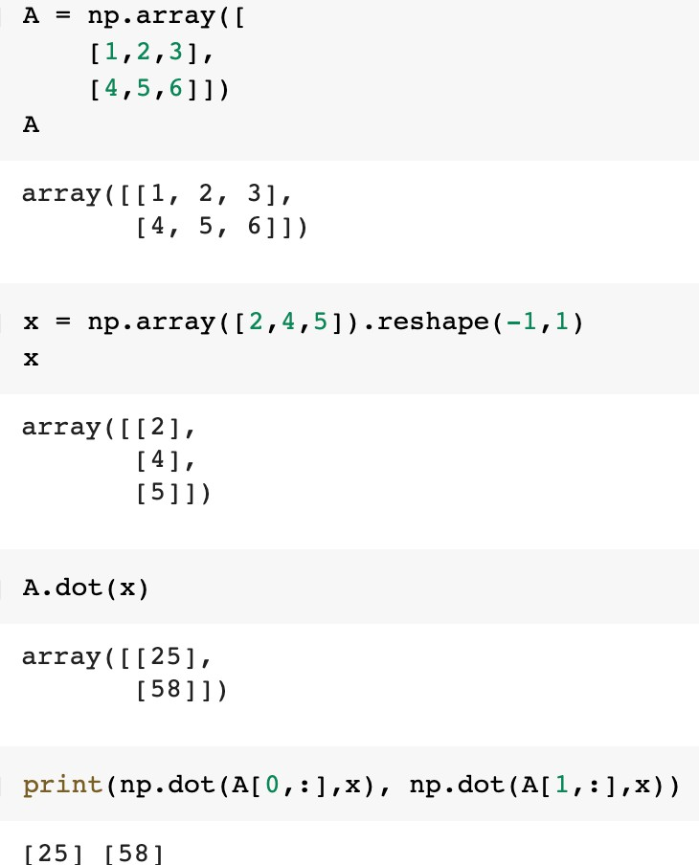
Matrix multiplication
Another formula
∑n
a …
ª1n
x₁
a x
11
i=1
1i i
⋮
ªm1
⋮
⋮ =
⋮
…
ªmn ^{x}n
∑n
i=1
ªmi^{x}i

Slide 5
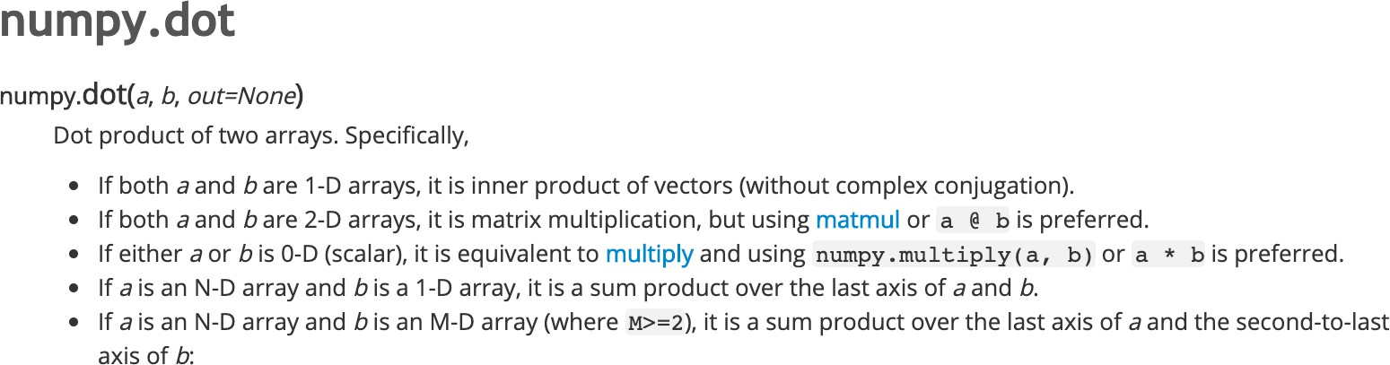
NumPy documentation

Slide 6
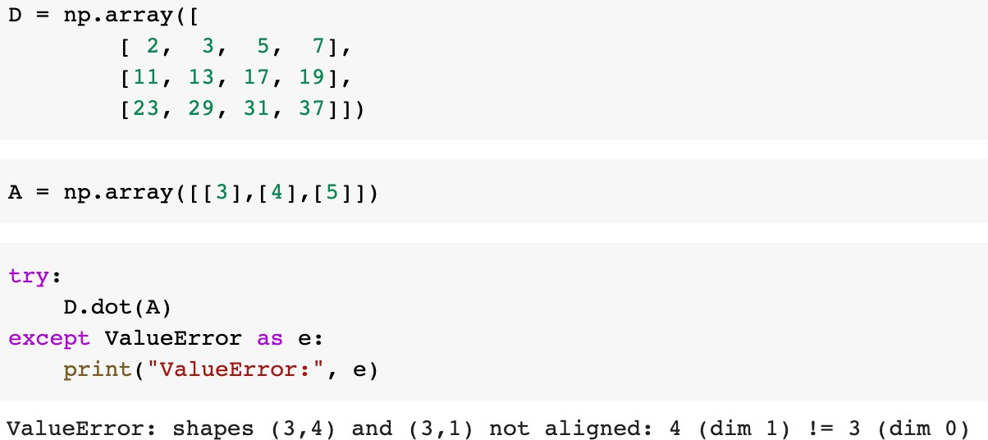
Matrix multiplication
Matrices can be multiplied if their neighboring dimensions match
A B = C
⏟
⏟
n×k k×m

Slide 7
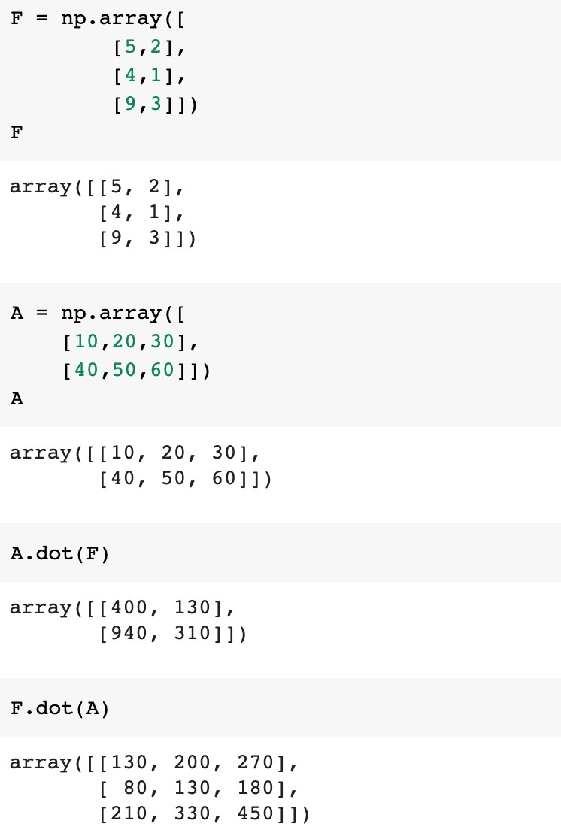
Matrix multiplication

Slide 8
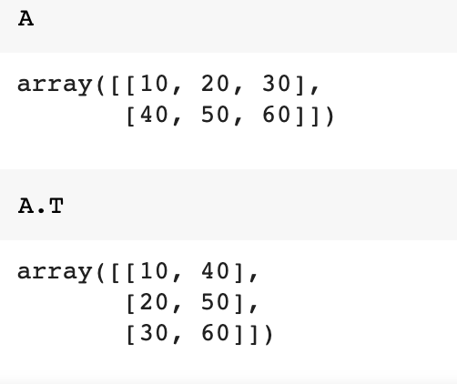
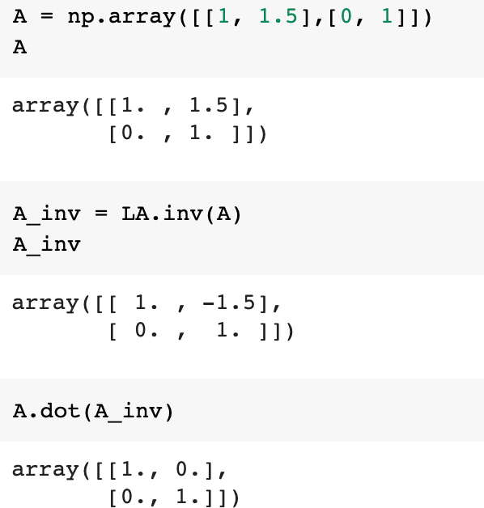
Other operations
Matrix transpose
Matrix inverse

Slide 9
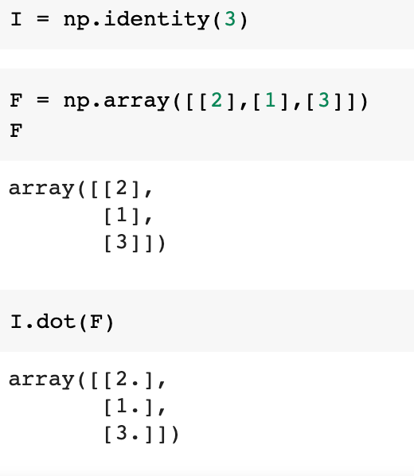
Identity matrix

Slide 10
Pandas

Slide 11
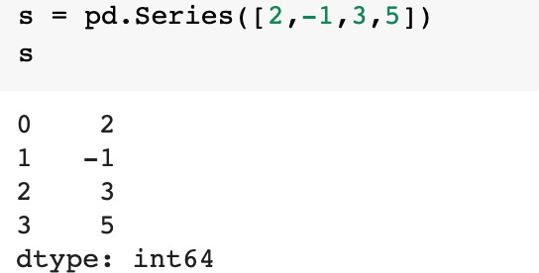
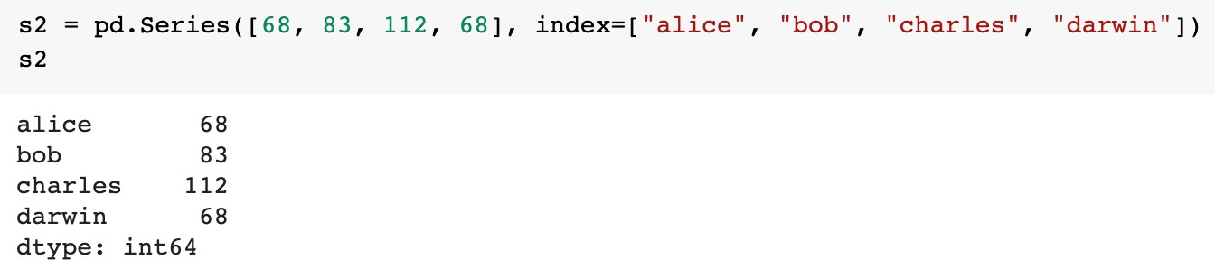
Pandas
Homework Week 2
The Pandas library provides high-performance and easy-to-use data structures
  DataFrame: 2D table like a spreadsheet with column names and row labels
  https://github.com/ageron/handson-ml2/blob/master/tools_pandas.ipynb
Series: 1D array or a column in a spreadsheet
Index label

Slide 12
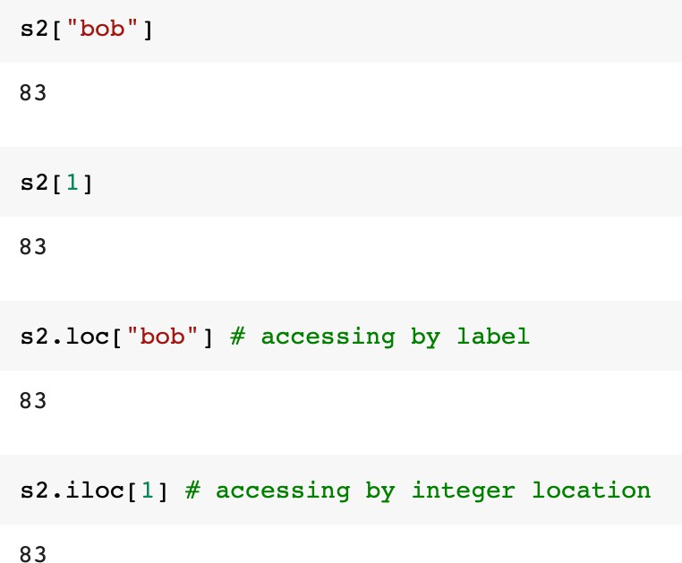
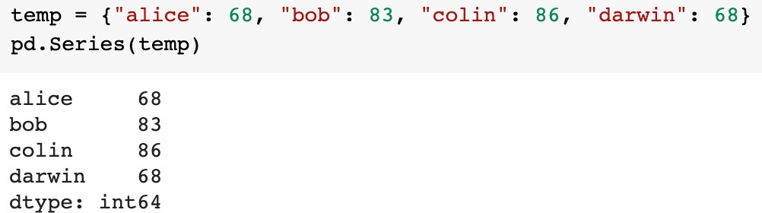
Series
Homework Week 2
Finding elements
Create Series from a dictionary

Slide 13
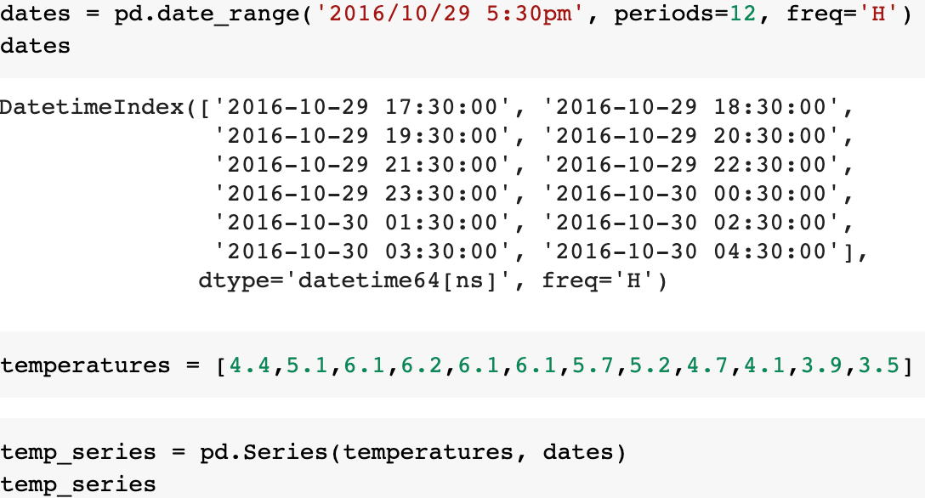
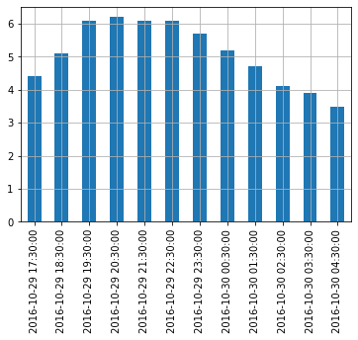

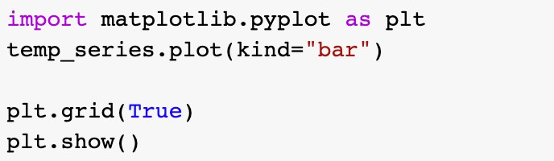
Time range
Homework Week 2

Slide 14
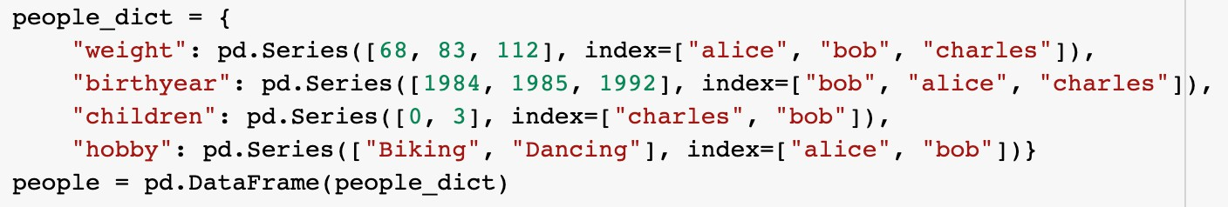
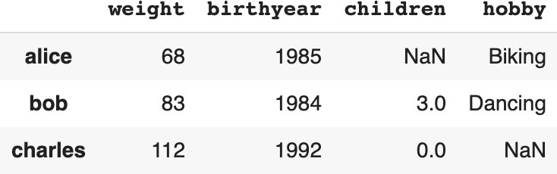
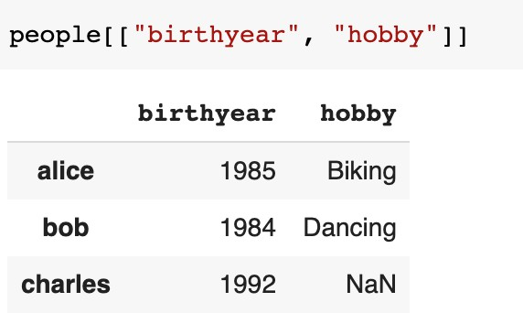
DataFrame
Homework Week 2
missing values
How to access columns?

Slide 15
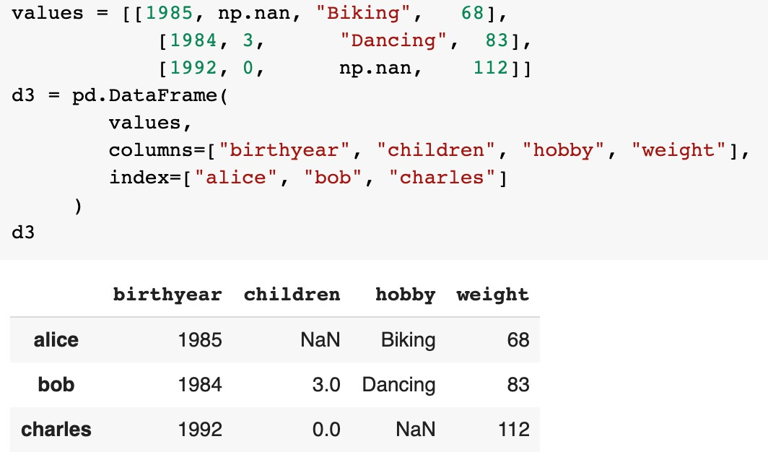
Another way to create DataFrame
Homework Week 2

Slide 16
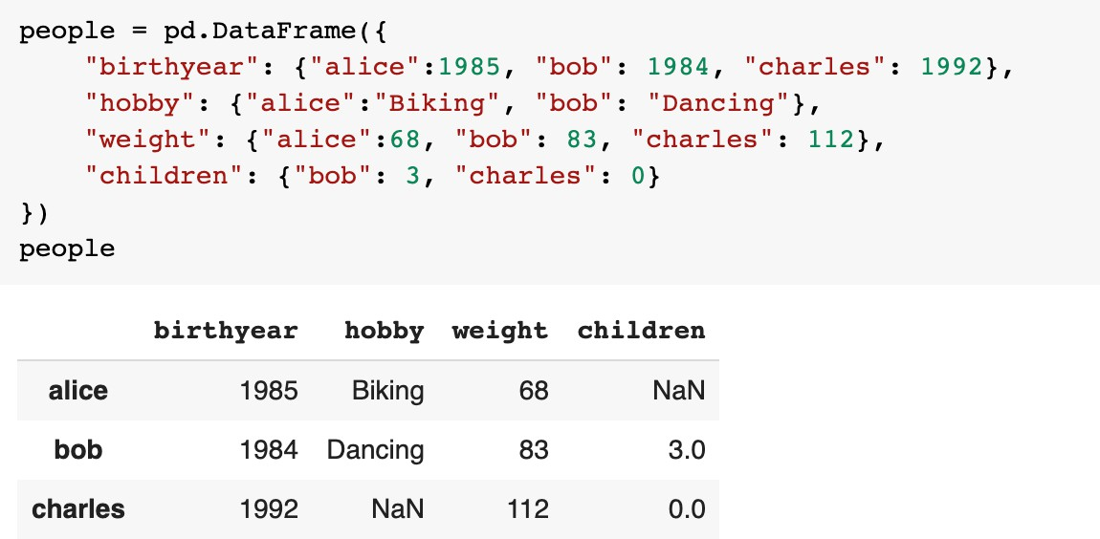
Another way to create DataFrame
Homework Week 2

Slide 17
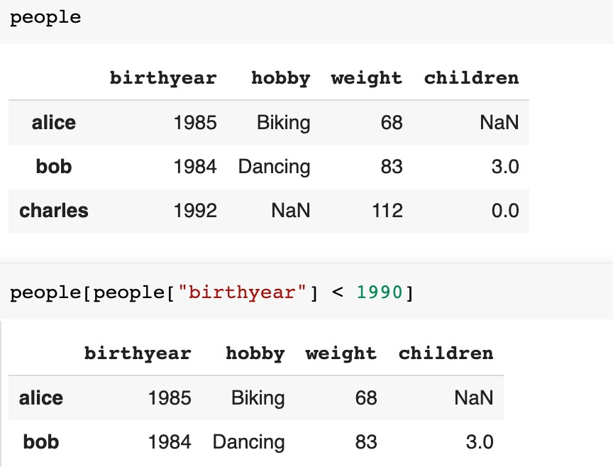
Accessing rows
Homework Week 2

Slide 18
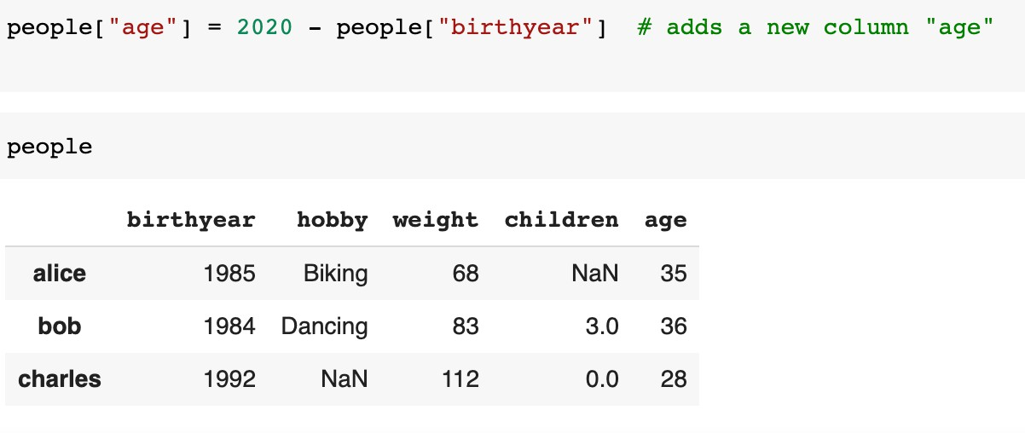
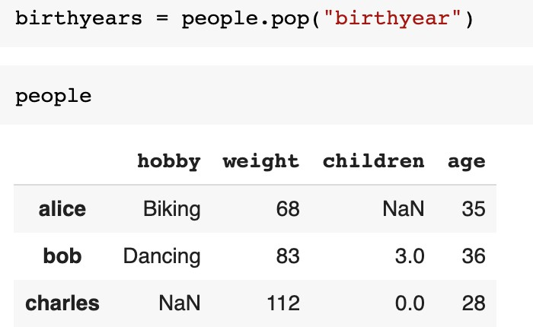
Adding/removing columns
Homework Week 2
Adding column
Removing column

Slide 19
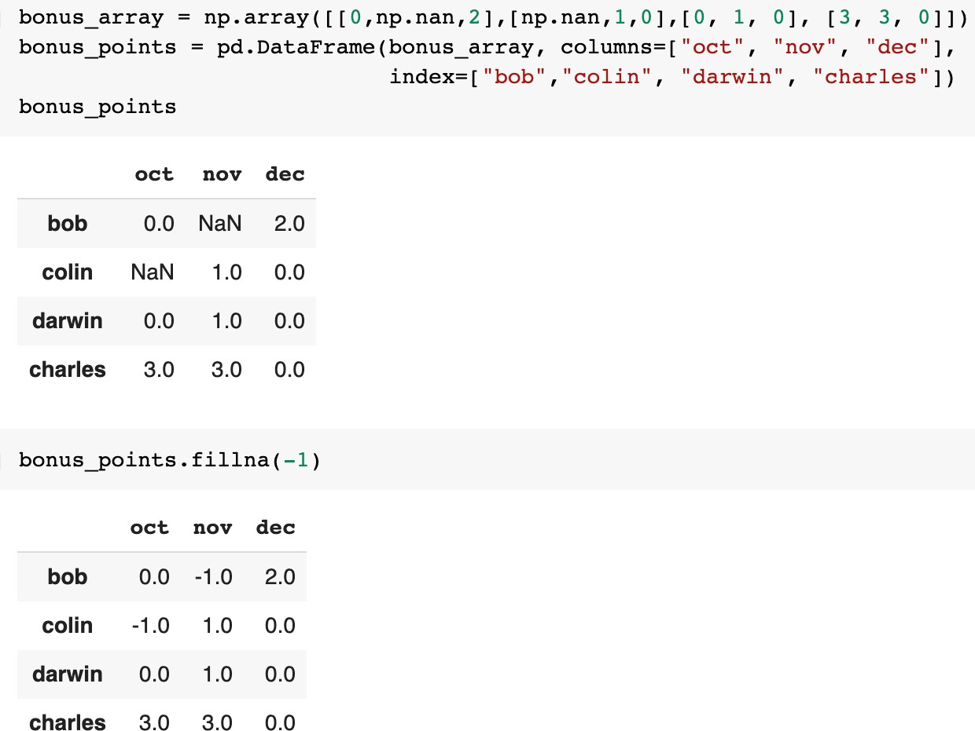
Handling missing data
Homework Week 2
Replace all NaNs by any value

Slide 20
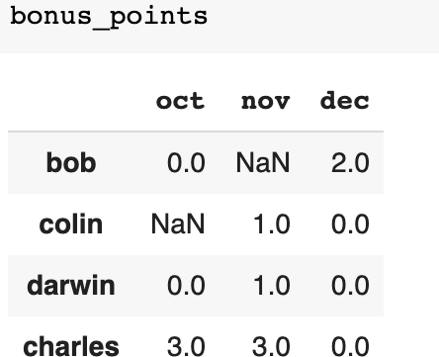
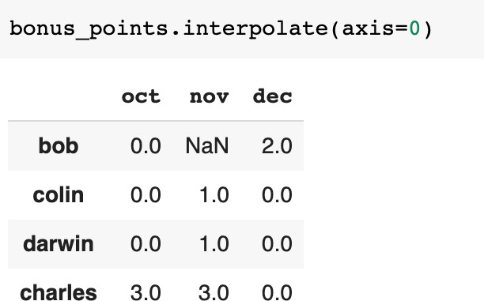
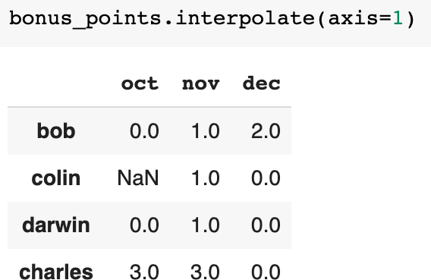
Handling missing data
Homework Week 2
Interpolation technique to fill in missing values

Slide 21
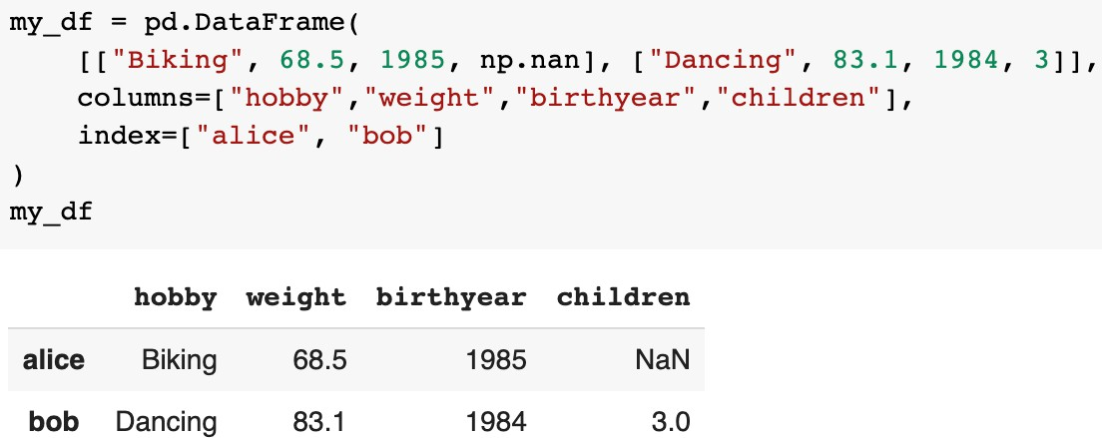
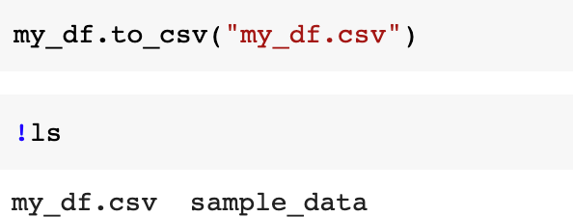
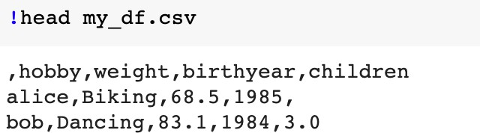
Saving
Homework Week 2
We usually save DataFrame to CSV

Slide 22
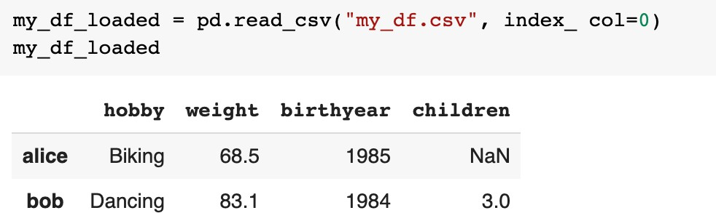
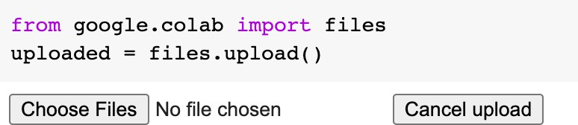
Loading
Homework Week 2
From saved CSV file
• How
How can you upload your CSV file?

Slide 23
Matplotlib

Slide 24
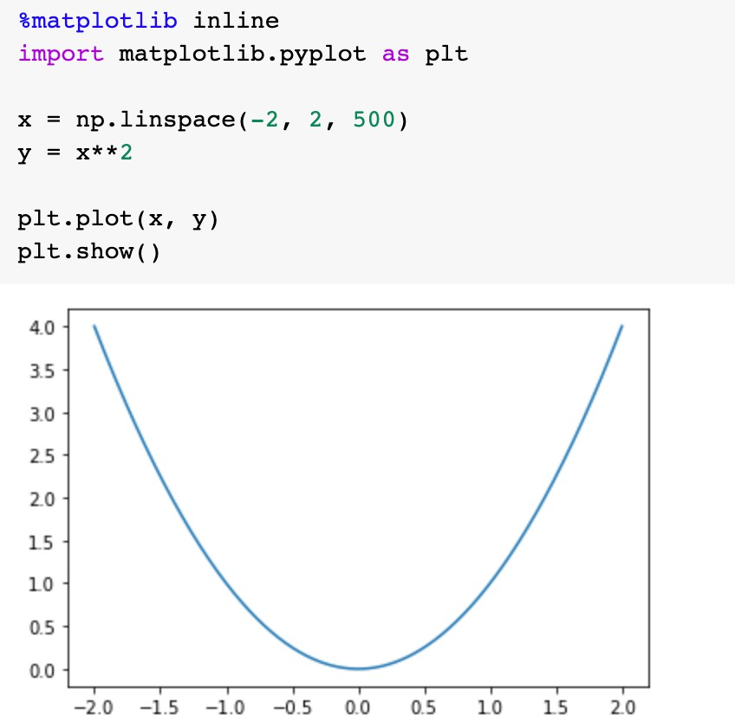
Matplotlib
Homework Week 2
Comprehensive library for creating visualizations in Python
  https://github.com/ageron/handson-ml2/blob/master/tools_matplotlib.ipynb

Slide 25
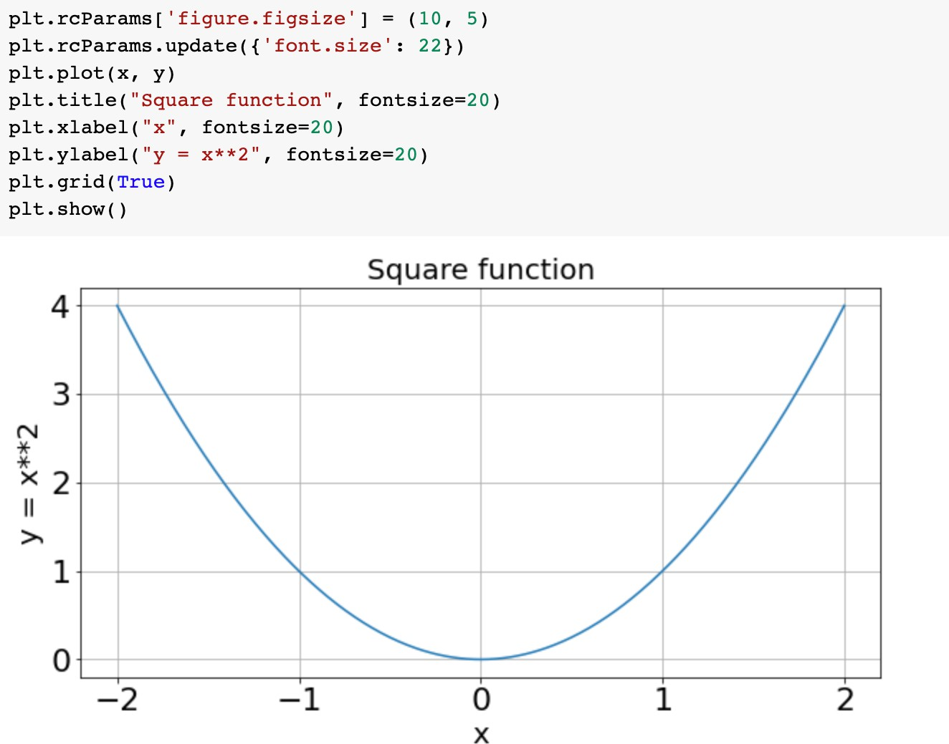
Customization
Homework Week 2
We can add title, axes labels, etc.

Slide 26
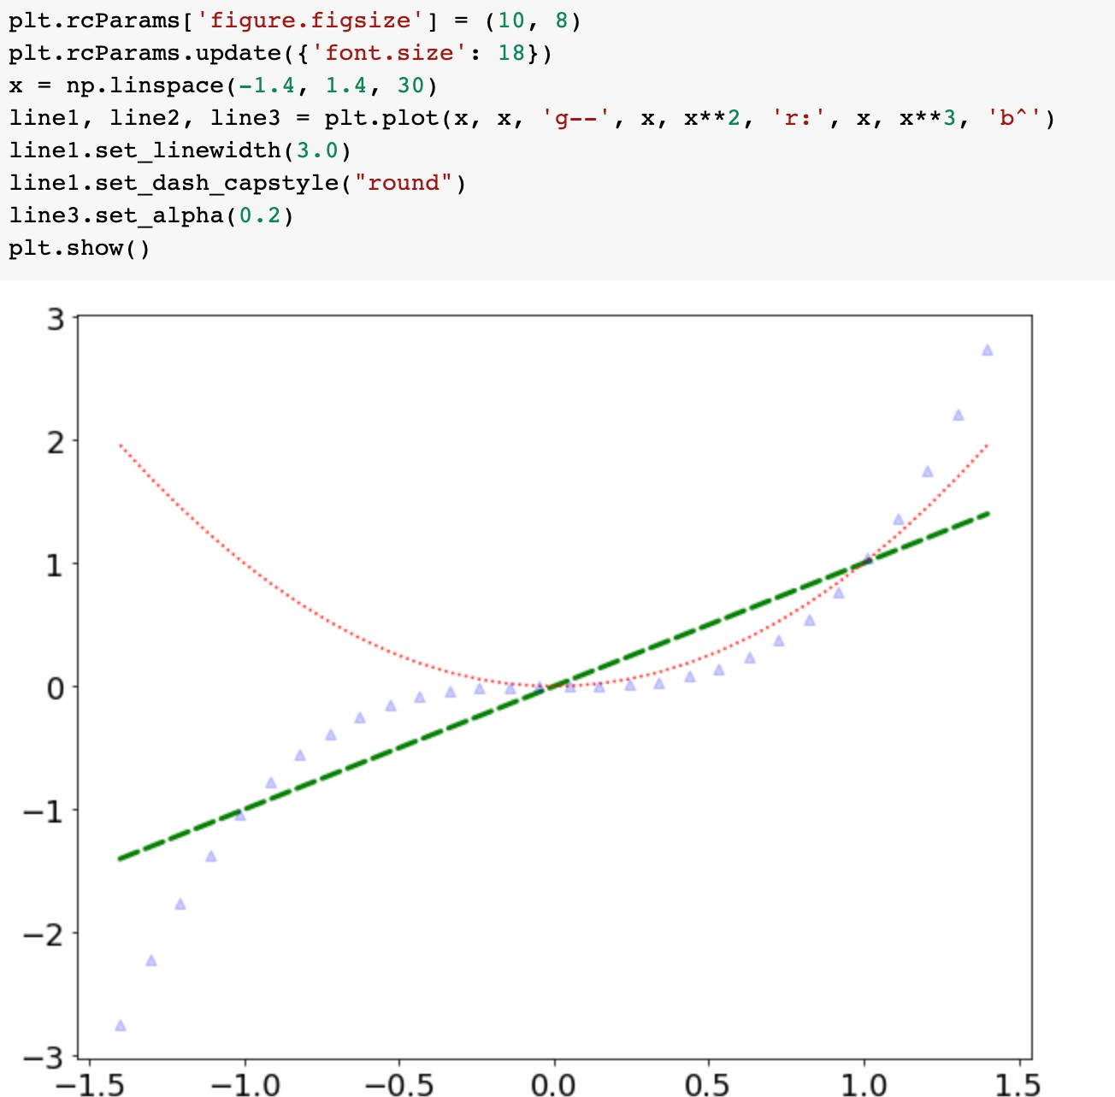
Customization
Homework Week 2

Slide 27
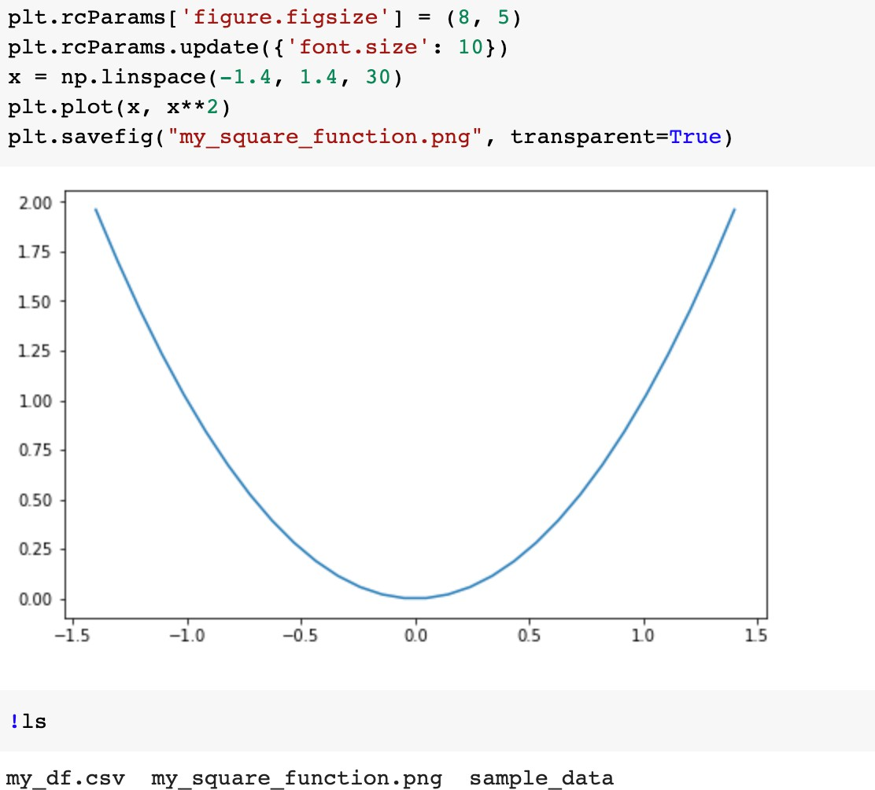
Saving a figure
Homework Week 2

Slide 28
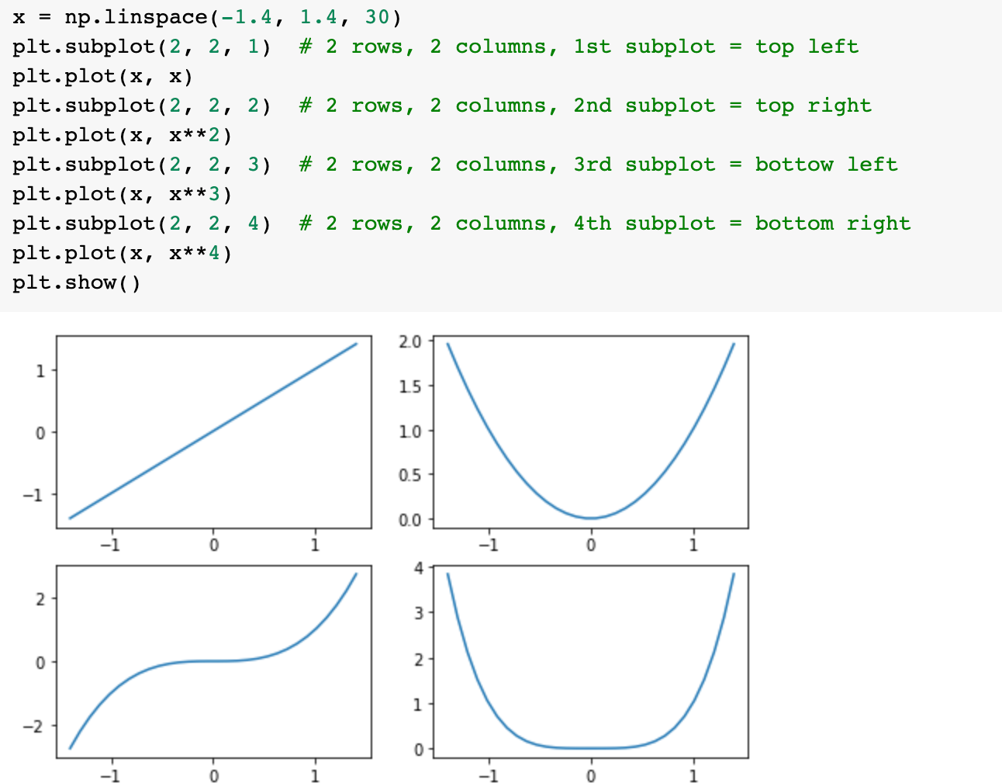
Subplots
Homework Week 2

Slide 29
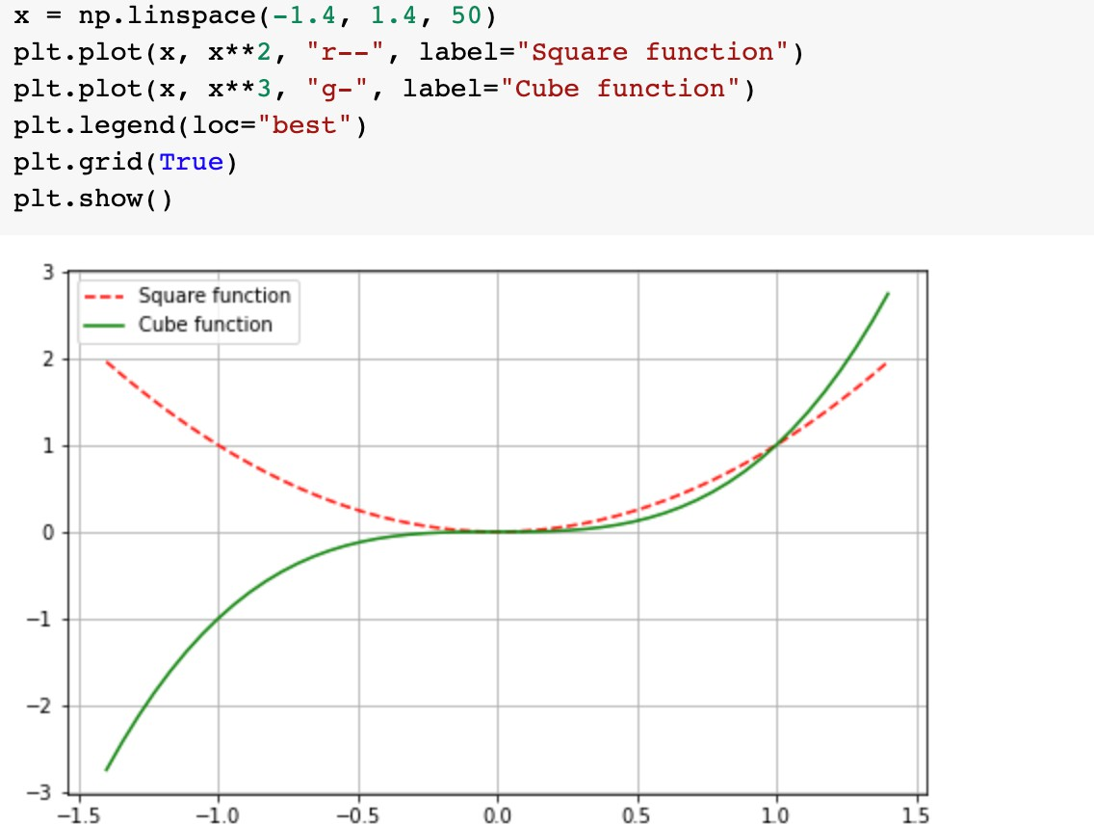
Legends
Homework Week 2

Slide 30
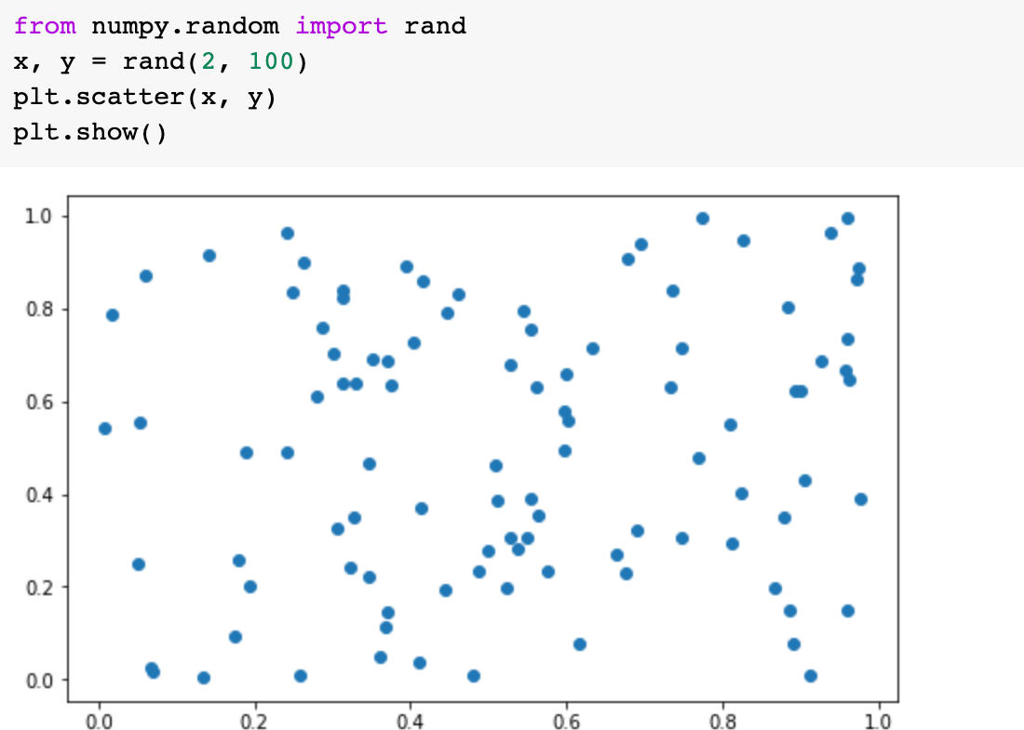
Scatter plot
Homework Week 2

Slide 31
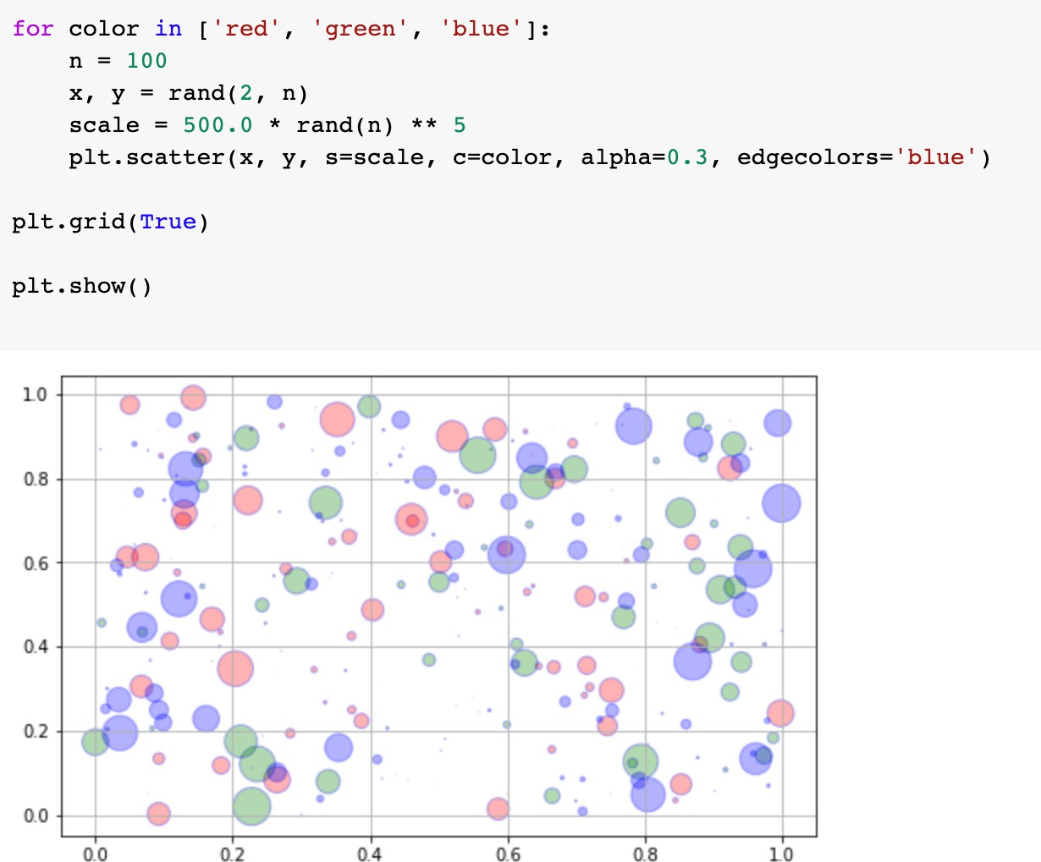
Scatter plot
Homework Week 2

Slide 32
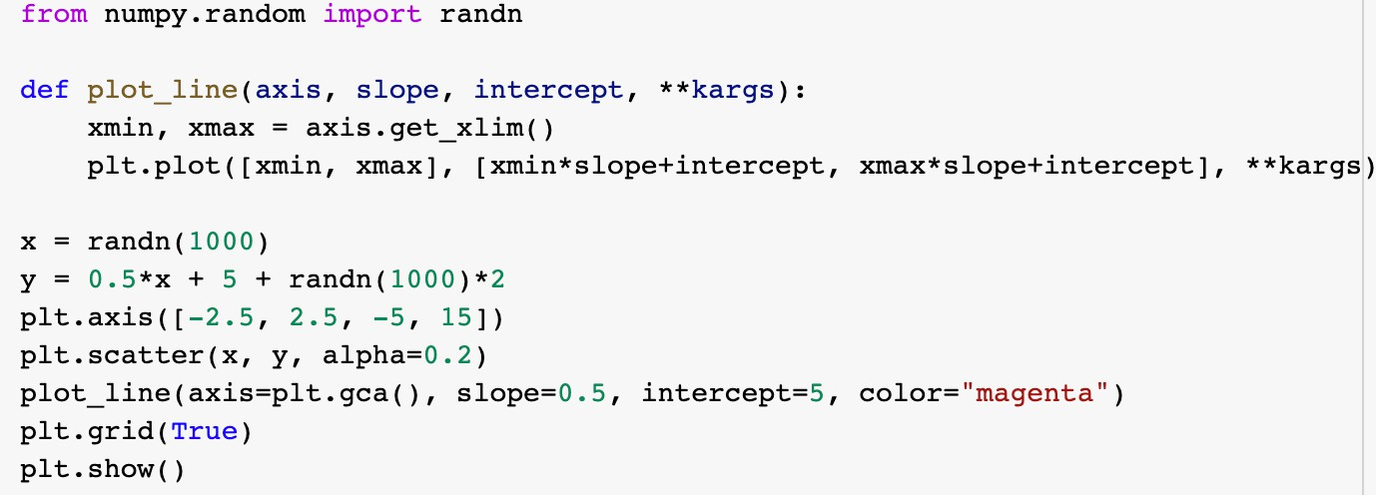
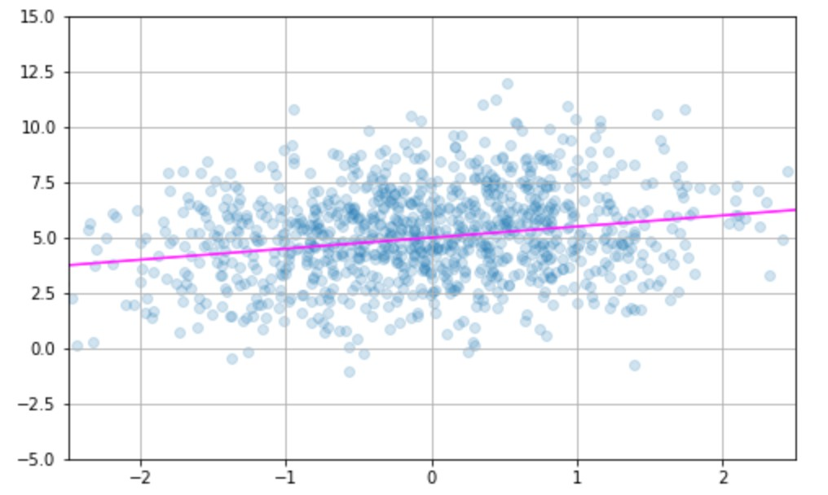
Utility function for plots
Homework Week 2
It is often convenient to create a utility function

